Slide 1
HACKATHON UIDAI
2021

Slide 2
Hackathon Details
Team Details
Team Name : Tesseract Gain
Team Reference ID : XEEZgdtvVL
Stage UID : 999905196379
Team Members
Priyam Sheth (Aadhaar - 3170 2556 6168)
Dishant Sakhida (Aadhaar - 3724 5936 8518)
Vikram Mali (Aadhaar - 9646 0266 6935)
Aman Vadher (Aadhaar - 6856 3196 4003)
Harsh Shah (Aadhaar - 7046 7393 6636)

Slide 3
Table Of Contents
01
02
03
04
Introduction
Solution Design
Explanation
Snap-Shots

Slide 4
Introduction
Hackathon UIDAI is the First Ever Event being conducted by Aadhaar. They have Given Two Themes for Hackathon :
ADDRESS UPDATE
AUTHENTICATION REIMAGINED
Out these themes, our team has chosen ADDRESS UPDATE under which, we will be merging the repeated words as one word and we will creating JSON API to show the Output in an Organised Form.

Slide 5
Solution Design
No
NULL
Input
Detect Commas
Length = 3
Output
Length = 4
Output
Yes
Length = 5
Output
Length = 6
Output
Length = 7
Output

Slide 6
Explanation
Our Team has chosen Address Update for Hackathon UIDAI 2021. In the Solution, we are taking the Input Address (With Commas) from the User and split the data. After splitting we are getting data in form of list. After that, we will be checking the Length of List. With that length, we have divided the variables and giving the specific output with respect to the length of List. We will be showing the output in an organised form with JSON API.
Here we have use :
VS CODE (Text Editor)
PYTHON (Code Language)
FLASK (Module for API)
MOZILLA FIREFOX (Output)

Slide 7
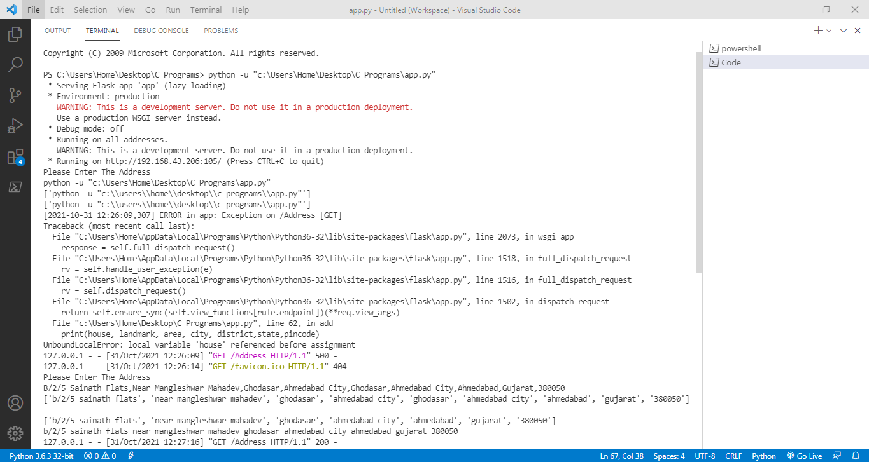
Snap-Shots
Taking Input From User

Slide 8
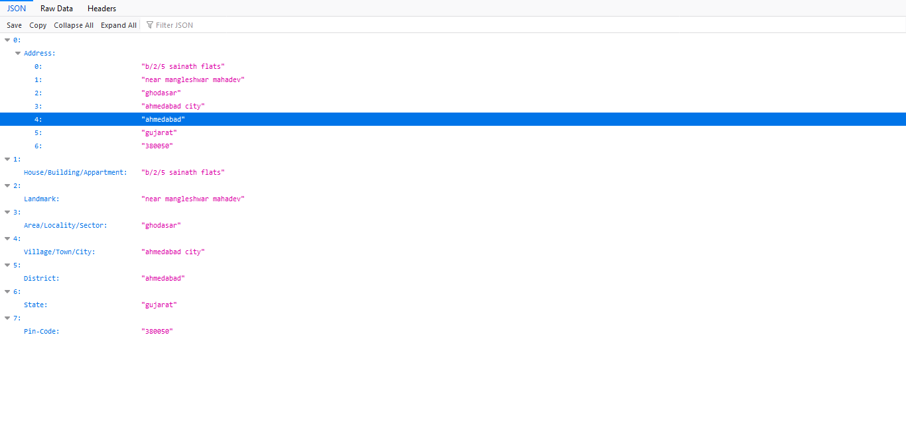
Output in an Organized Form

Slide 9
Thank You
Presented By : Tesseract Gain Team

